Slide 1
Project HRM by Alpha-Q
Presentors:
Ninad PARAB
AADESH HEMWANI
TABISH KHAN
TUSHAR ANNAM

Slide 2
What exactly this project is going to do?
Salary calculation of employees based on their leaves, attendance record etc.
Tracking leaves, reimbursements, meeting logs for employee
Manager approval system for management people where managers can approve employee leaves, reimbursements, and meeting logs.
Simple and convenient environment for basic admin related tasks like adding employees salary calculations

Slide 3
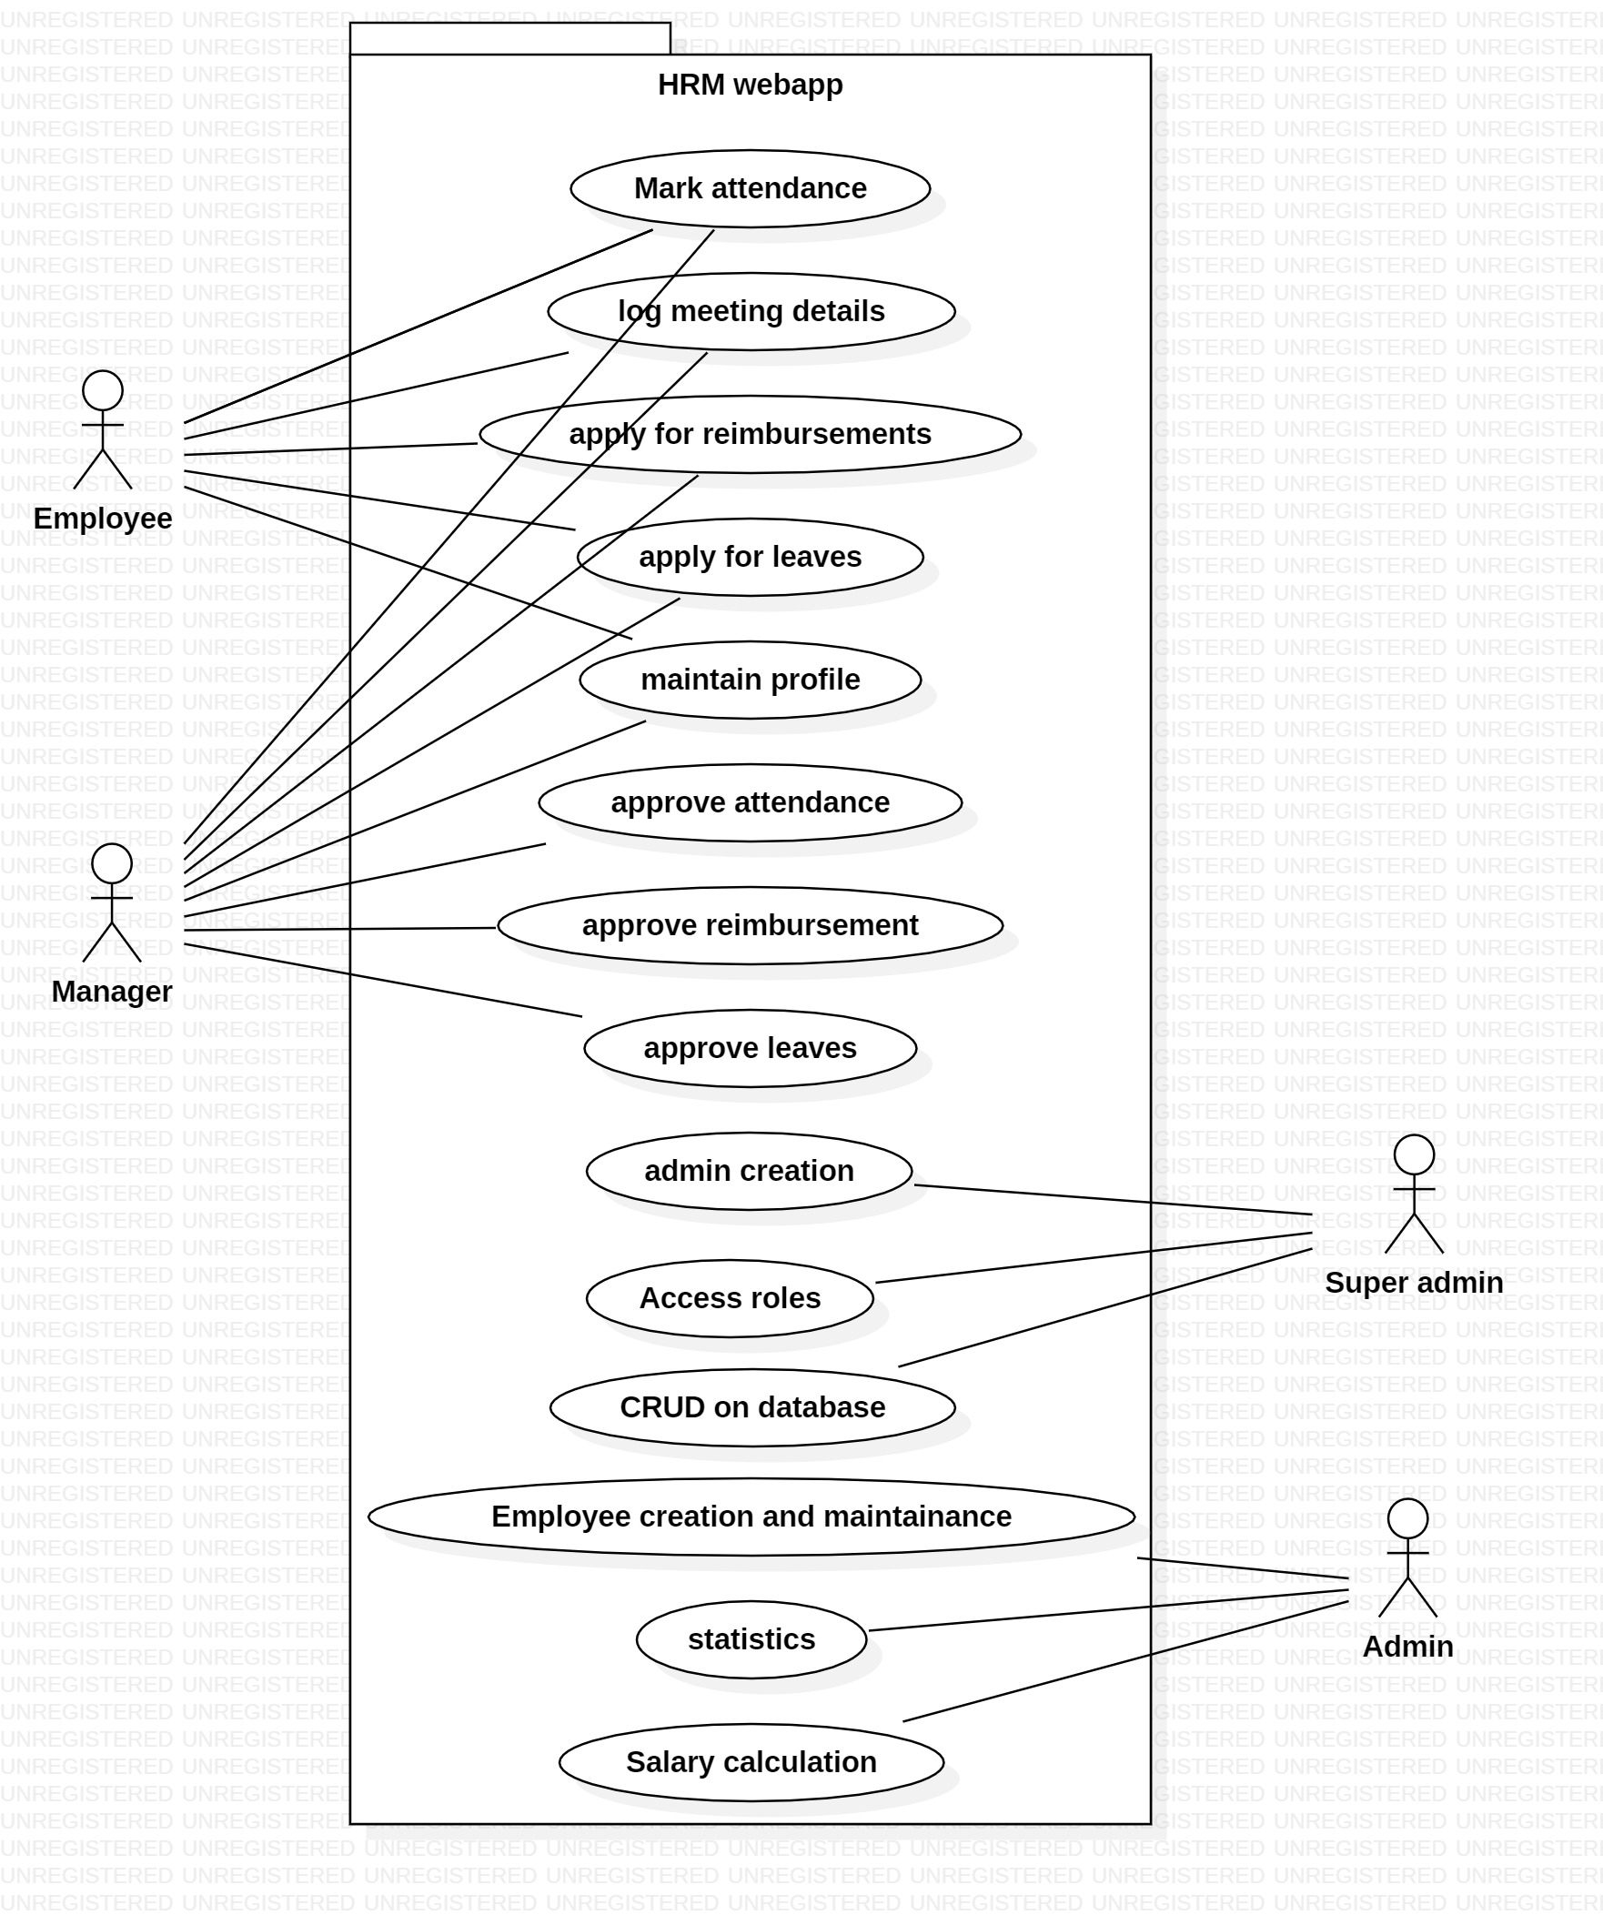
Project idea

Slide 4
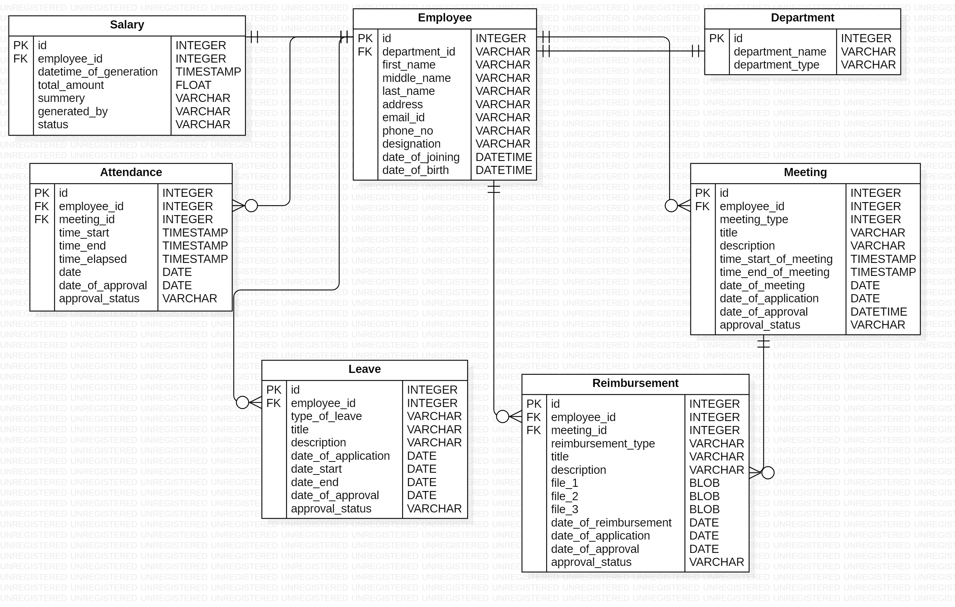
DB design idea(Basic idea)

Slide 5
How we are going to implement
Technology stack:
Django framework
Bootstrap 4 with open source theam pack SB-admin2
HTML,CSS, Javascript(Jquery)
Libraries:
Django tables2
Jquery data tables
Django admin theme(DJANGO-GRAPPELLI)
django-notifications-hq

